Slide 1



CARBON EMMISION PREDICTION

Slide 2

Learning Objectives
Understand global carbon emission patterns and their correlation with climate change.
Learn data preprocessing techniques, including handling missing values, encoding categorical data, and removing outliers.
Perform Exploratory Data Analysis (EDA) using visualization tools such as Matplotlib and Seaborn to uncover hidden patterns.
Implement machine learning models, especially regression techniques like Linear Regression and Random Forest.
Evaluate model performance using standard metrics like Mean Absolute Error (MAE), Mean Squared Error (MSE), and R² Score.
Apply insights from predictions to support climate policy decisions and encourage sustainable development planning.
GOAL
Source code :
https://github.com/Nandanarenjith/AICETE-PROJECT-CARBON-EMISSION-

Slide 3


Tools and Technology used
Python: Programming language used.
Pandas, NumPy: For data manipulation.
Matplotlib, Seaborn: For data visualization.
Scikit-learn: For machine learning algorithms and evaluation metrics.
Google collab: Development environment.
Joblib : For model saving/loading if persistence is used
RandomForestClassifier : Data Modeling

Slide 4

Methodology
Data Collection – Acquired a carbon emission dataset from a trusted source.
Data Cleaning – Handled missing values, formatted columns, and removed outliers.
Exploratory Data Analysis (EDA) – Visualized trends using scatter plots, pairplots, and correlation matrices.
Feature Selection – Identified features highly correlated with carbon emissions.
Model Building – Applied Linear Regression and Random Forest Regression.
Model Evaluation – Used MAE, MSE, and R² scores to validate performance.
Hyperparameter Tuning – Improved the model using GridSearchCV

Slide 5

Problem Statement:
Carbon emissions are a major contributor to climate change. Predicting future carbon
emissions based on current trends can help in designing effective mitigation strategies. This
project aims to analyze factors influencing emissions and build a model to predict future
values.

Slide 6
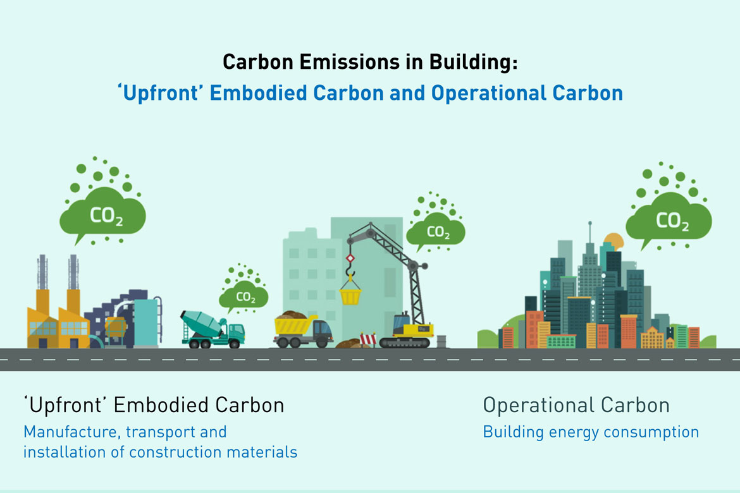
Solution:
Built a regression-based machine learning model to predict CO₂ emissions using historical data and relevant influencing factors.
Explored multiple algorithms including Linear Regression and Random Forest Regressor to compare performance and accuracy.
Used correlation analysis to select impactful features such as energy consumption, industrial activity, and economic indicators.
Preprocessed the dataset by handling missing values, encoding categorical data, and scaling features for better model efficiency.
Evaluated models using metrics like MAE (Mean Absolute Error), MSE (Mean Squared Error), and R² Score to ensure robust predictions.

Slide 7
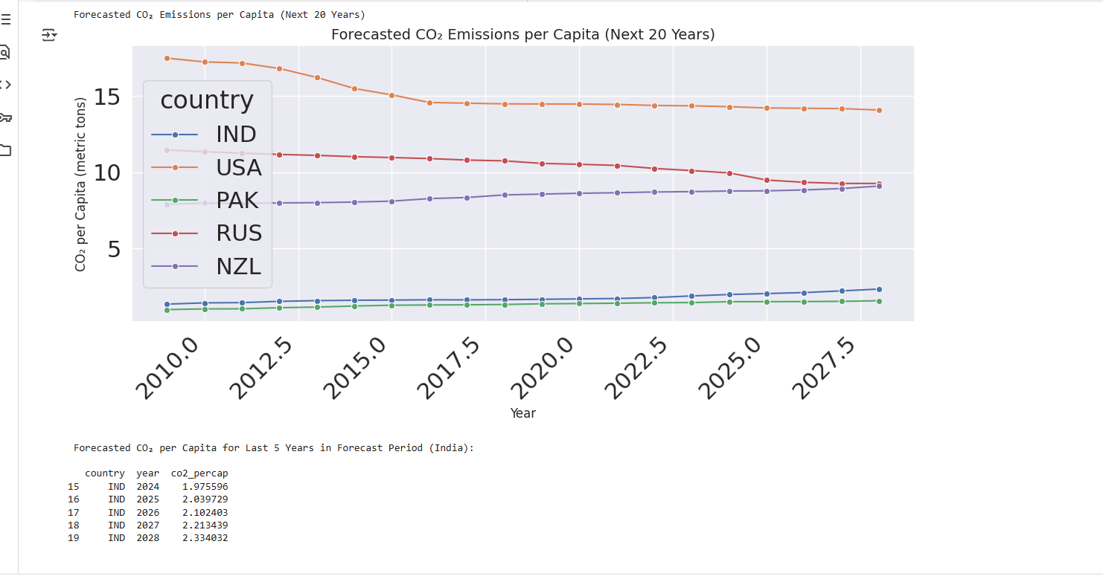
Screenshot of Output:

Slide 8
SUMMARY OF TASKS (WEEK 1-3)
Week -1 task
understood the problem and preparing the dataset by cleaning missing values, correcting formats, and removing outliers
Week –2 task
Understood how to perform an exploratory data analysis using visualization tools to identify patterns and selected key features based on correlation
Week –3 task
Learnt evaluated machine learning models like Linear Regression and Random Forest Regressor, using metrics such as MAE, MSE, and R² to measure performance and select the best model for carbon emission prediction.

Slide 9
Conclusion:
Learning outcomes from (tasks 1-3):
Successfully developed a predictive model for carbon emissions.
Learned key ML concepts: regression, model tuning, and evaluation.
The project promotes environmental responsibility through AI-based insights.
Can be scaled by integrating real-time data or other pollution-related metrics.

Slide 10
THANKYOU

